Slide 1
Car Price Prediction
Akash Kanjwani

Slide 2
ACKNOWLEDGMENT
During the process of completing this project, I have referred following materials for which I owe them great gratitude.
1.Data collection- Using Web scraping tool i.e. Selenium
2. Car24.com for collecting the data https://www.cars24.com/
3. Data trained video tutorials.
4. Scikit-learn https://scikit-learn.org/stable/
5. Machine Learning for Dummies by John Mueller and Luca Massaron - Easy to understand for a beginner book.
6. Geeksforgeeks. https://www.geeksforgeeks.org/
Besides that all the observation, creations of the models and graphs done by self help.

Slide 3
Problem Statement-
Car price prediction is anyhow interesting and popular problem. Accurate car price prediction involves expert knowledge, because price usually depends on many unique features and factors. The main aim of this project is to predict the price of used cars using the various Machine Learning (ML) models. This can enable the customers to make decisions based on different inputs or factors Generally, most important ones are brand name and model, years, KMs driven and mileage. The fuel type used in the car as well as fuel consumption per mile highly affected price of a car due to often changes in the price of a fuel.
The project Car Price Prediction deals with providing the solution to these problems. Through this project, we will get to know which of the factors are significant and tell us how they affect the car’s worth in the market.
Motivation for the Problem Undertaken
With the covid 19 impact in the market, we have seen lot of changes in the car market. Now some cars are in demand hence making them costly and some are not in demand hence cheaper. One of our clients works with small traders, who sell used cars.
With the change in market due to covid 19 impact, our client is facing problems with their previous car price valuation machine learning models. So, they are looking for new machine learning models from new data. We have to make car price valuation model.

Slide 4
Analytical Problem Framing
Mathematical/ Analytical Modeling of the Problem
1) The size of table is 5104*7 i.e. no. of rows are 5100 and no. of columns are 7(including target).
2) Out of 7 columns 2 columns are continuous in nature and rest 5 are object type.
3) Null values are not present in the data set as we can see in ths seaborn heatmap, so there is no need to adopt imputation techniuqe.
4) In case of object data type, we will apply the encoding technique to convert the values in the numeric format.
In order to scrape the data we got some garbage data as well like:
car name column had many unusefull information.
year of purches and Kilometers_Driven columns had present in the form fo object datatype.
In every row of price column and Kilometers_Driven column comma(,) was present.
we had some empty space in between the columns.
We seperate the car's company names and created one new column name called company.
All the above garbage data we removed from the dataset with the help of pandas functions.

Slide 5
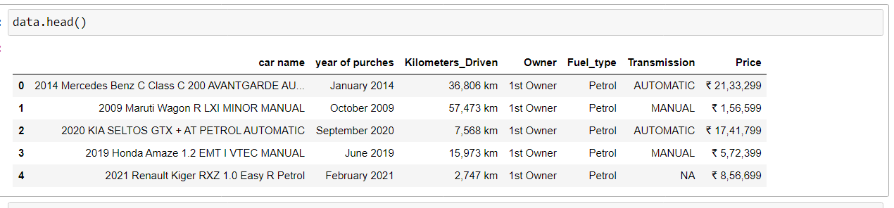
In our dataset only 3 columns are showing some outliers that is price, year of purches and kilometers driven. Because the mean is 44586 and standard daviation is 31501 and maximum max values is 400055 which is very higher and reason of outliers.
High Skewness is present in the kilometers driven column(2.21), shown that data data are not equally distributed.
Data Sources and their formats
Initially we did not data, For getting the data we used web scraping selenium tool.
Data source- https://www.cars24.com/

Slide 6
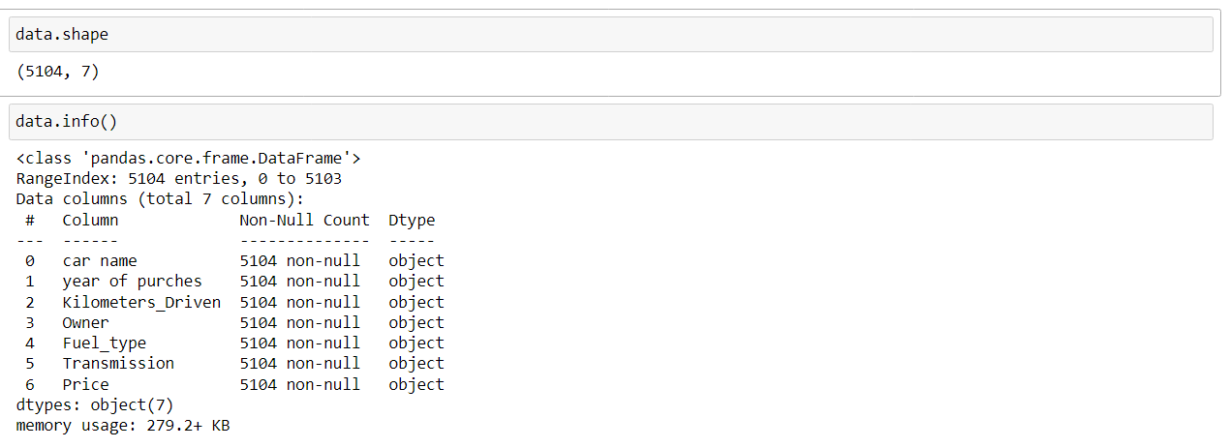
Data Pre-processing Done
Outliers, Skewness, Data scaling, Data Cleaning
We had outliers in some columns and also skewed data was present in our data set. To Clean the data we have performed following steps.
• For outliers removing we used z score method.
• For skewness removing we used power transformation.
• For Data scaling we used Min max scaler.
Encoding the data with the help of label encoder.
Data cleaning using pandas function.

Slide 7
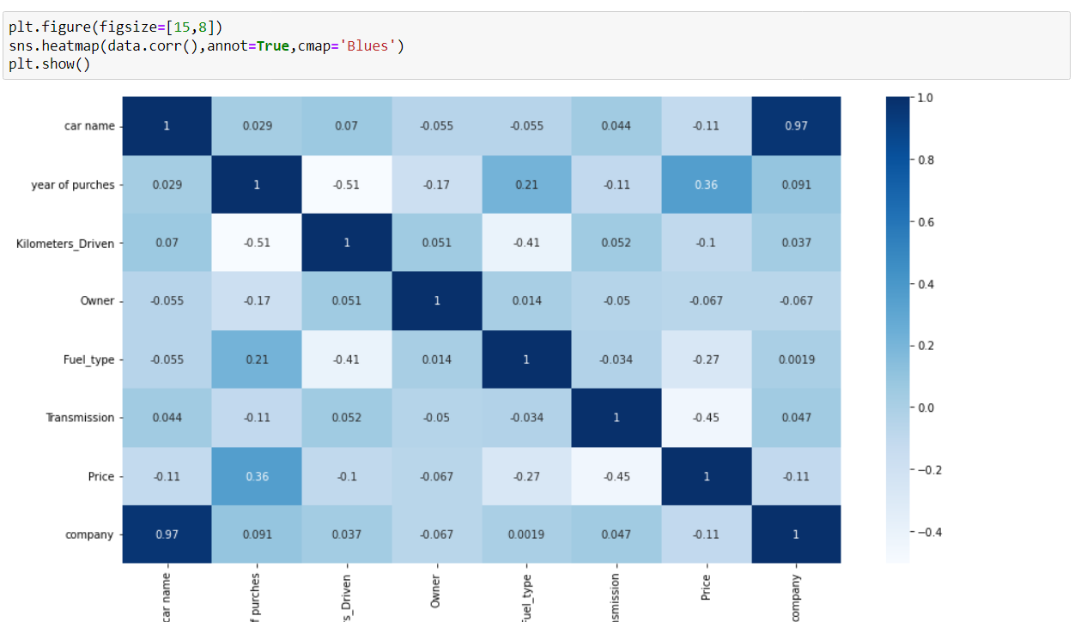
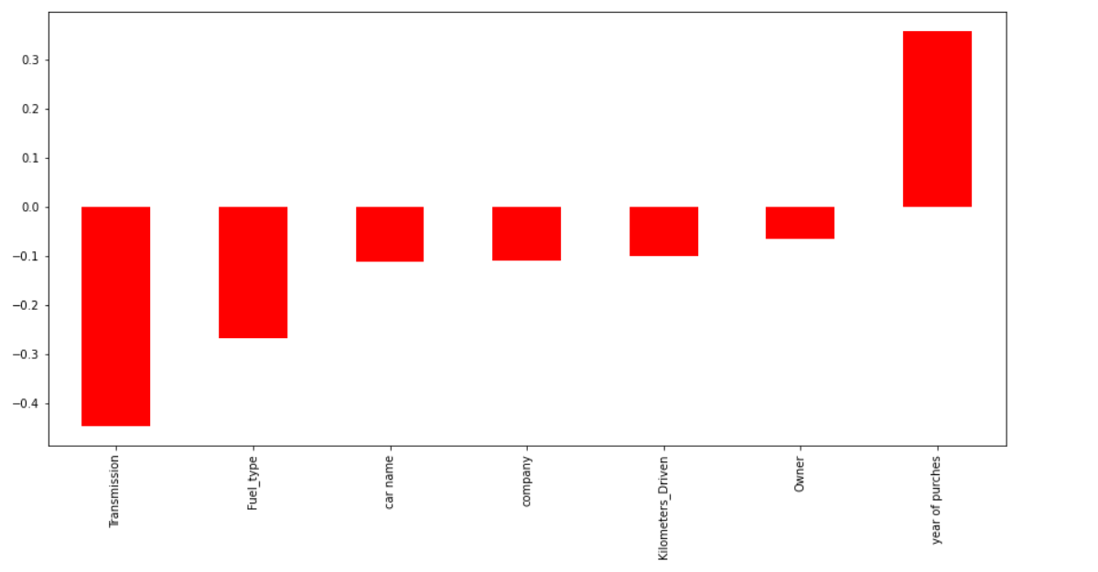
Data Inputs- Logic- Output Relationships

Slide 8
year of purches column making positive correlation with the target column.
transmission, fule_type, car name, company, owner and kilometers driven column are making negative correlation with the target column.
car name and company columns making a strong correlation with each other, means one will increase another will also increase.
Those car prices are high which have been purchesed from the year 2014 to 2021.
The prices are high when someone is going to buy automatic transmission car.
The car prices are high when the car owner stats is 1st owner and 2nd owner as compare to others
Hardware and Software Requirements and Tools Used
Anaconda Navigator
Jupyter Notebook
Language-Python
Selenium
Many lib.-------
import pandas as pd
import matplotlib.pyplot as plt
import seaborn as sns
import numpy as np
import warnings
import selenium
warnings.filterwarnings('ignore')
from sklearn.preprocessing import power_transform

Slide 9
from scipy.stats import zscore
from sklearn.preprocessing import MinMaxScaler
import statsmodels.api as si
from scipy import stats from statsmodels.stats.outliers_influence
import sklearn
from sklearn.linear_model import LinearRegression,Lasso,Ridge,ElasticNet
from sklearn.model_selection import train_test_split,GridSearchCV,cross_val_score
from sklearn.tree import DecisionTreeRegressor
from sklearn.svm import SVR
from sklearn.neighbors import KNeighborsRegressor
from sklearn.ensemble import RandomForestRegressor,AdaBoostRegressor,GradientBoostingRegressor
import xgboost as xg from sklearn.metrics
import mean_squared_error,mean_absolute_error,r2_score
Pandas- For making data frame
Matplotlib and seaborn- For data visualization
Numpy- For numerical python
ZScore- For removing outliers
MInMAxScaler- For data scaling
Power transform-For removing skewness
From metrice - mean_squared_error,mean_absolute_error,r2_score -For checking the model accuracy.
Regression- For regression modeling
Ensamble- For boosting and bagging
Grid search cv- For hyperparameter tuning
Cross_Val_Score- For cross validation

Slide 10
Model/s Development and Evaluation
Approaches Firstly it is import to know about which type of modelling we are going to construct, For this problem we used regression models because our target variable is numerical type and we had to predict the house prices. When we go for regression we have to use some metrics like mean_squared_error, mean_absolute_error, r2_score In order to do this work we have to find out the best random state by which we can achieve good accuracy. Then we split our data set into the train part and test part using train test split. When we done with the modelling we have to use cross validation for real accuracy(without underfitting and overfitting). Hyperpameter is must for increasing the model accuracy in order to build good model for this we use Grid search cv. We followed all the above approaches to build our Machine learning model.
Algorithms
• Linear Regression
• Decision Tree Regressor
• KNeighbors Regressor
• Support Vector Regressor
Ridge regressor
Lasso regressor
For Bagging and boosting:
• Random Forest Regresssor
• Gradient Bossting Regressor
• AdaBoost Regressor
• XgBoost Regressor

Slide 11
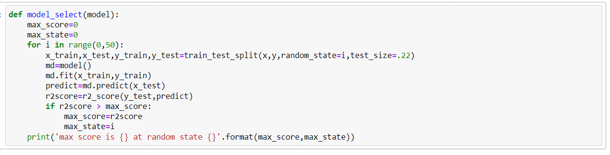

Slide 12
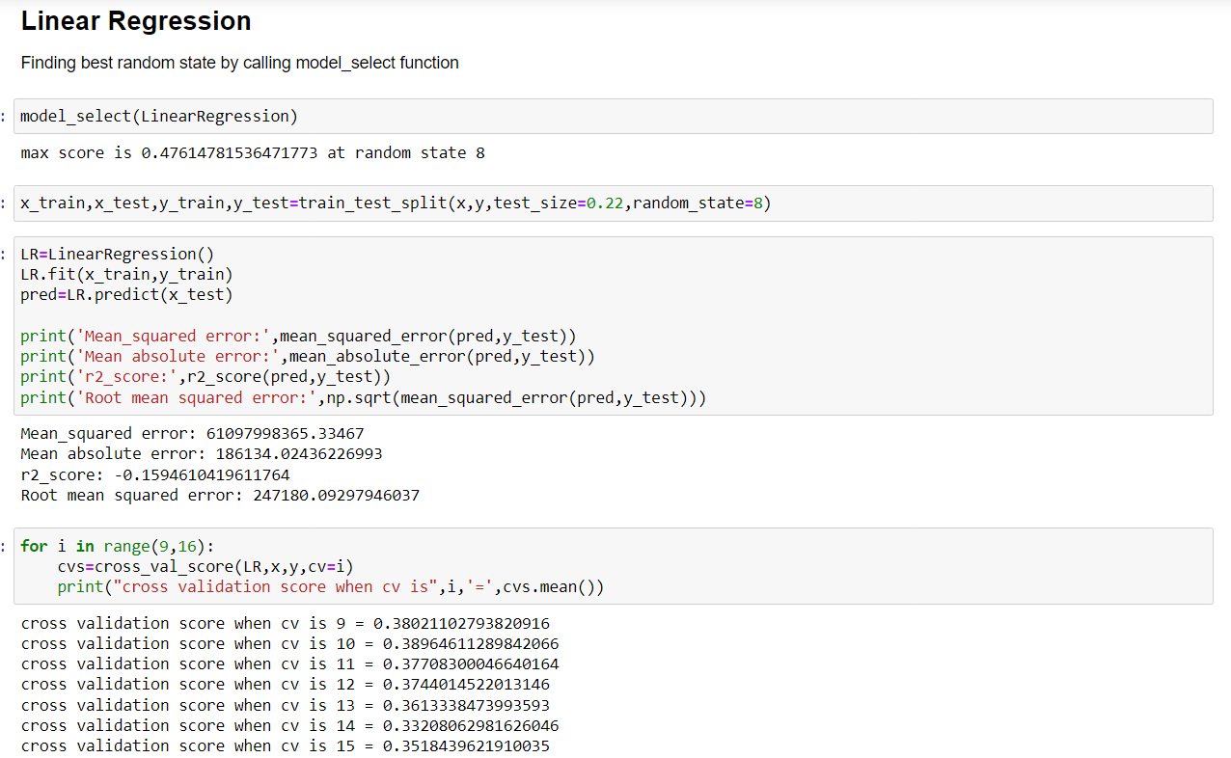

Slide 13
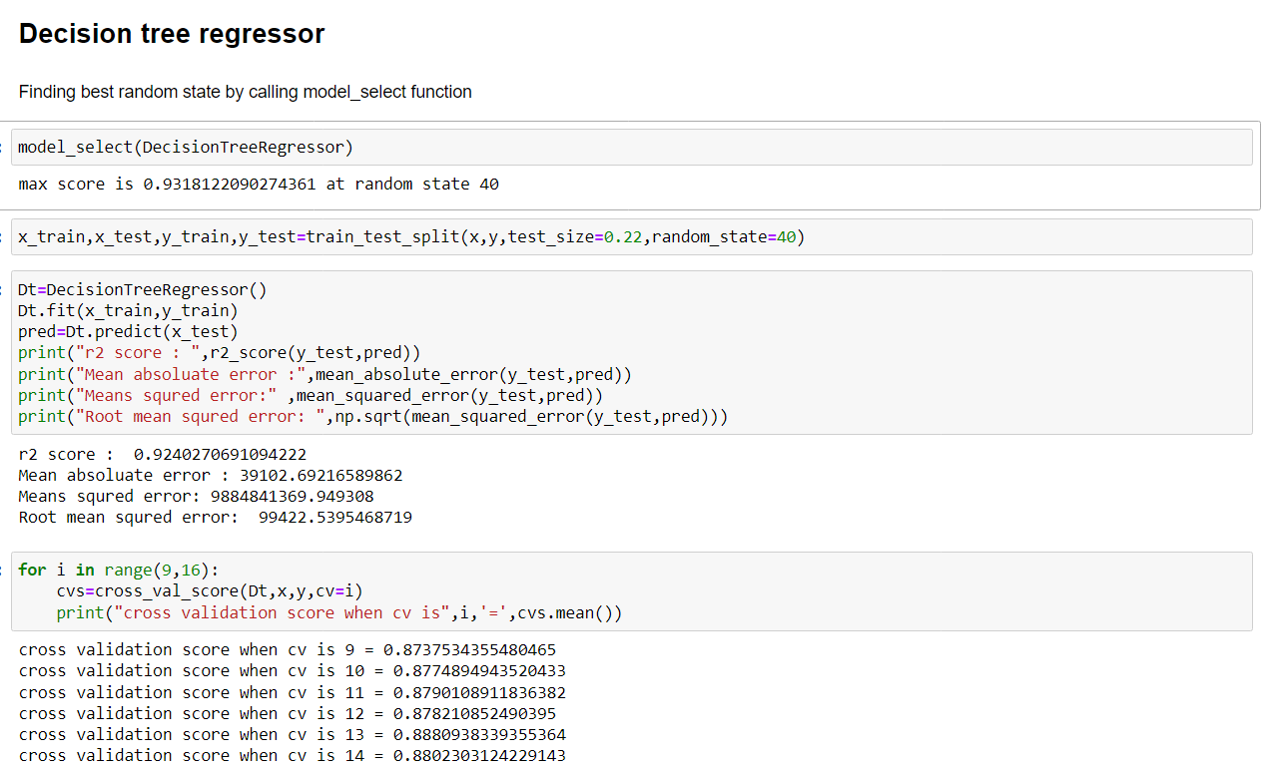

Slide 14
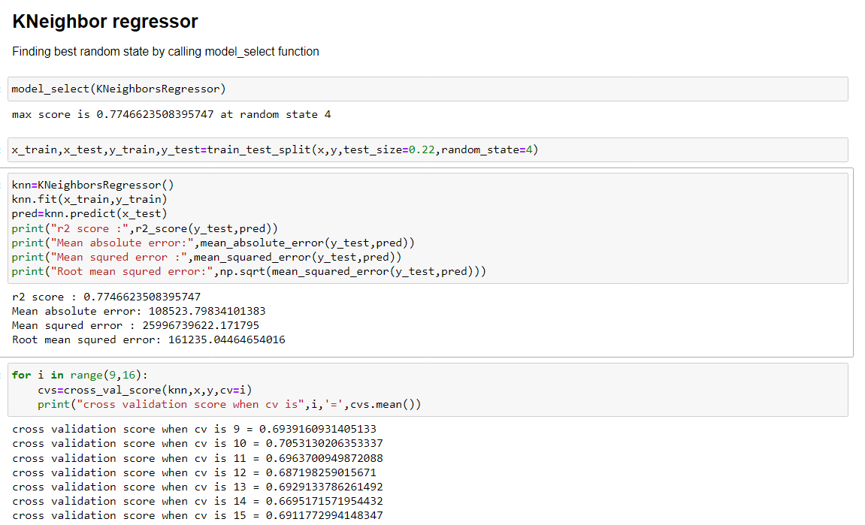

Slide 15
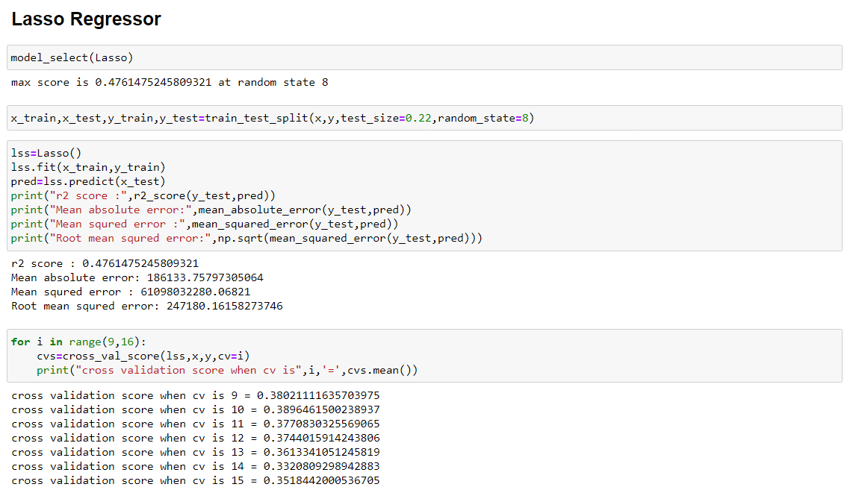

Slide 16
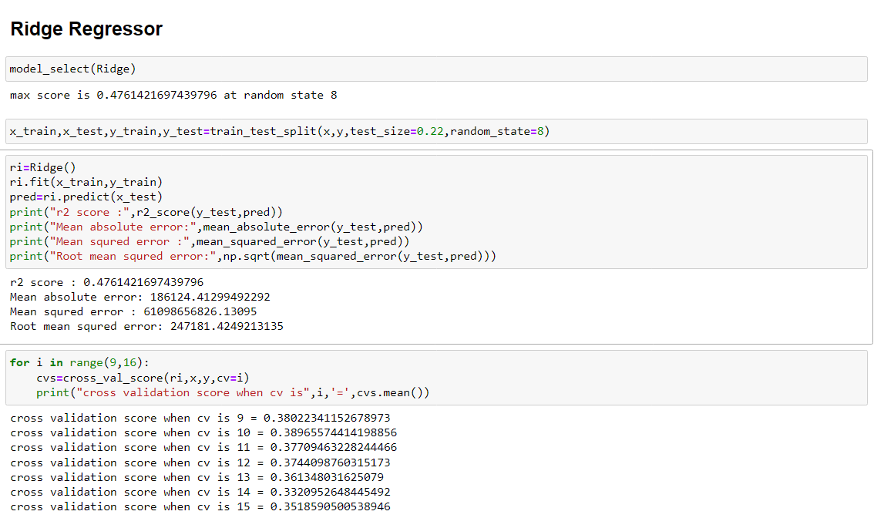

Slide 17
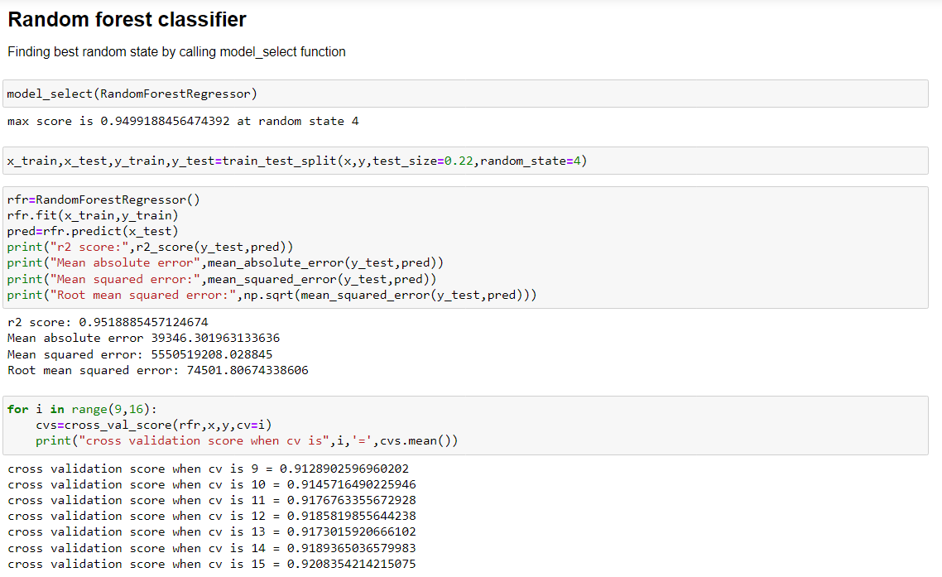

Slide 18
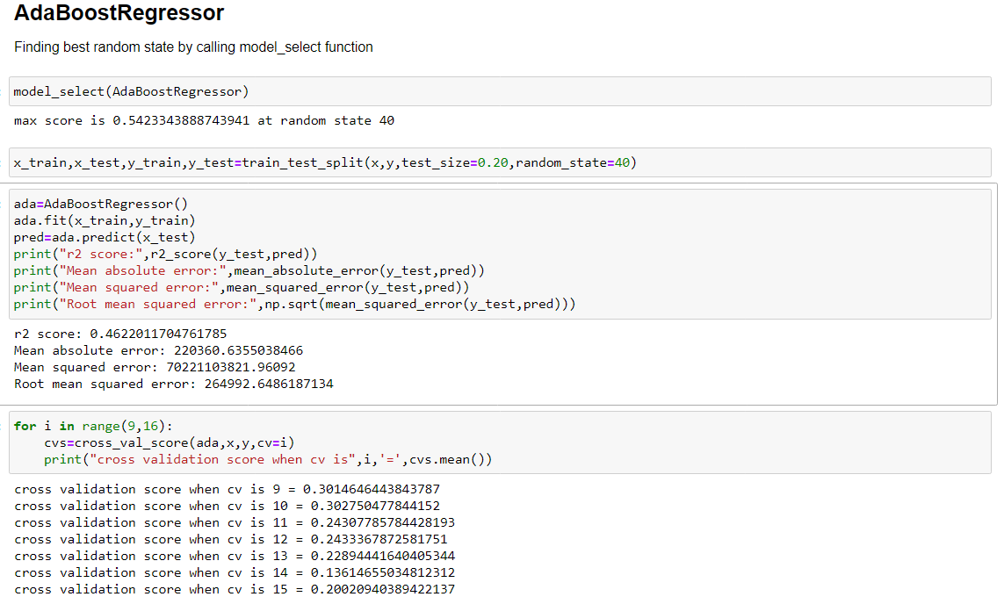

Slide 19
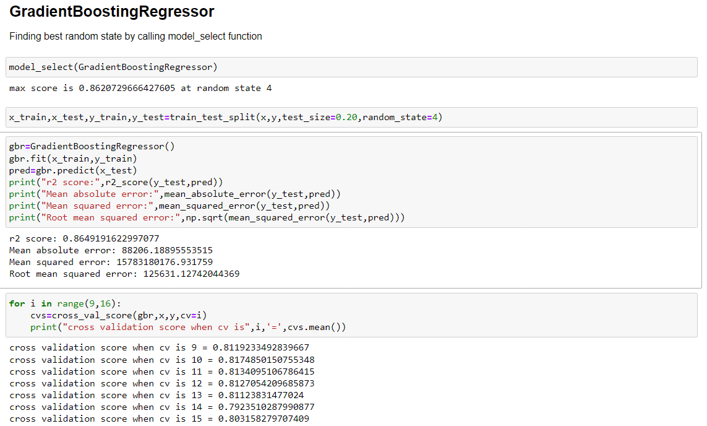

Slide 20
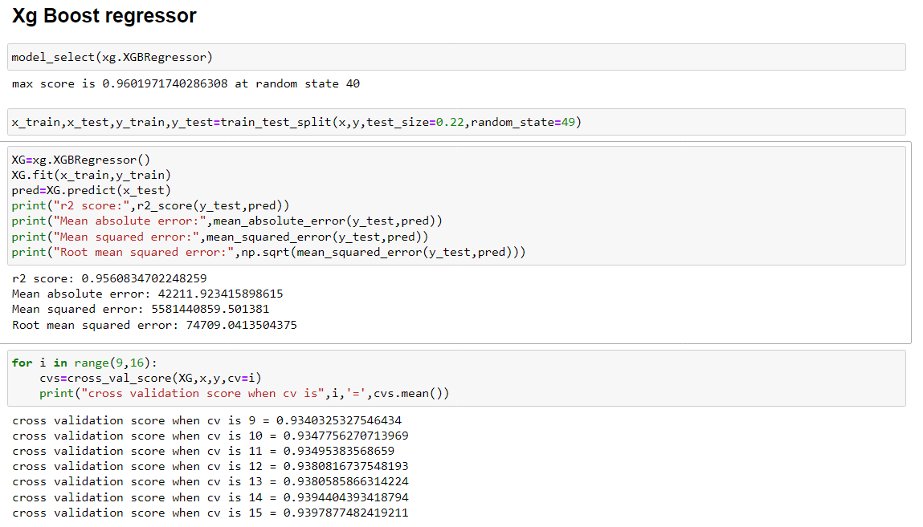

Slide 21
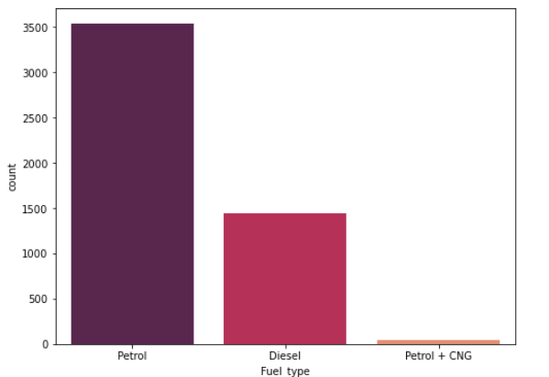
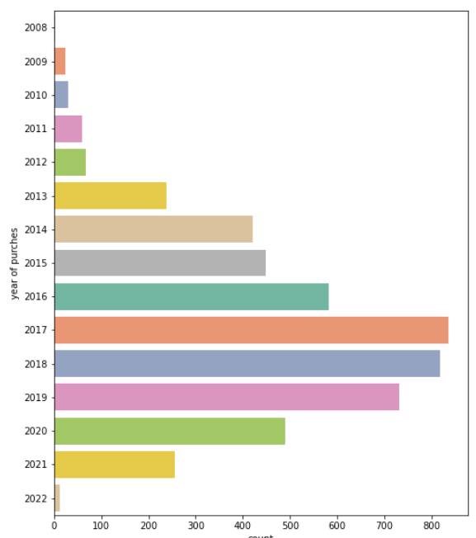
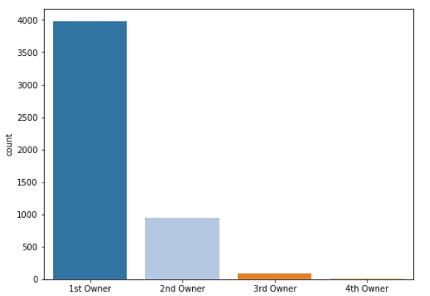
Visualizations

Slide 22
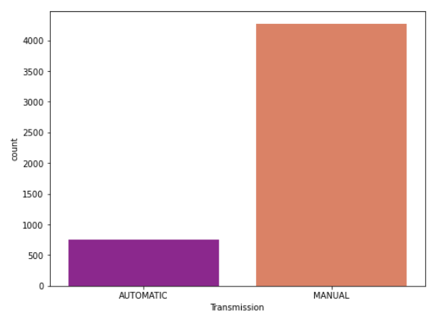
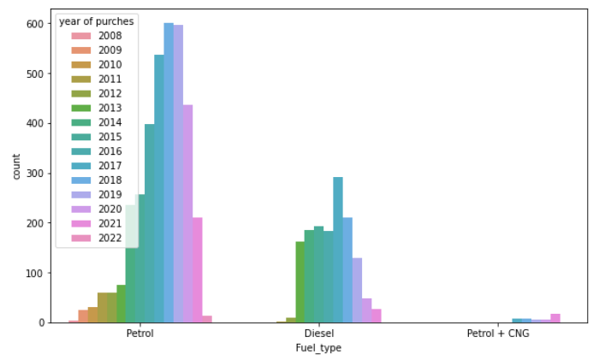
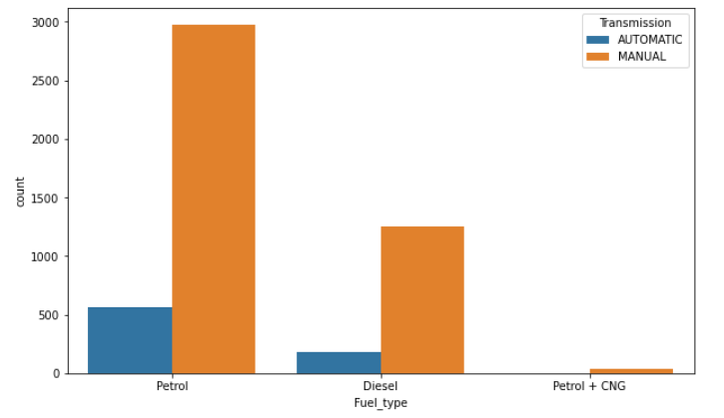
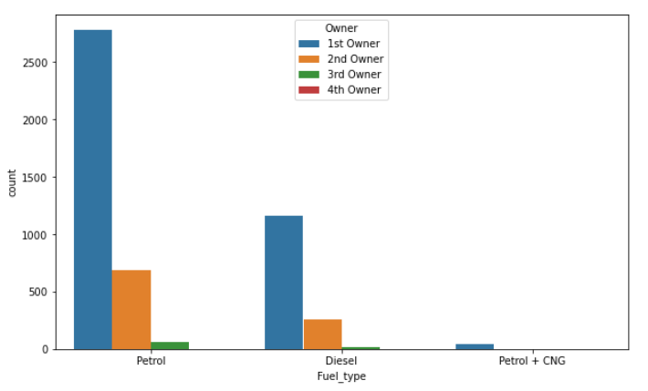

Slide 23
In our collected dataset, The number of petrol cars are higher(3535), Diesel cars are also being used in a good amount of number(1439), CNG based cars are fewer in number(43).
Most of the used cars are being sold by the 1st owner, So the chances of price will be increased. Less cars are avilable in the section of 2nd owner and 3rd owner.The count of 4th owner cars are negligible.
When we see the used car's tranmission, The number of automatic transmission cars is very high and automatic transmission cars are less.
It is important to know the year of purches, when you go for buying a used car, here we can see that most of the cars are purchesed in the 2013 to 2017.Some cars are avilable in our dataset which had been bought in 2008 to 2012.
CONCLUSION

Slide 24
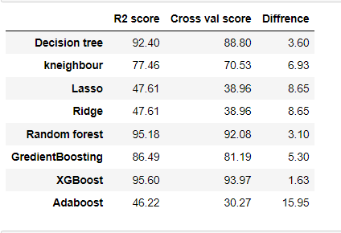
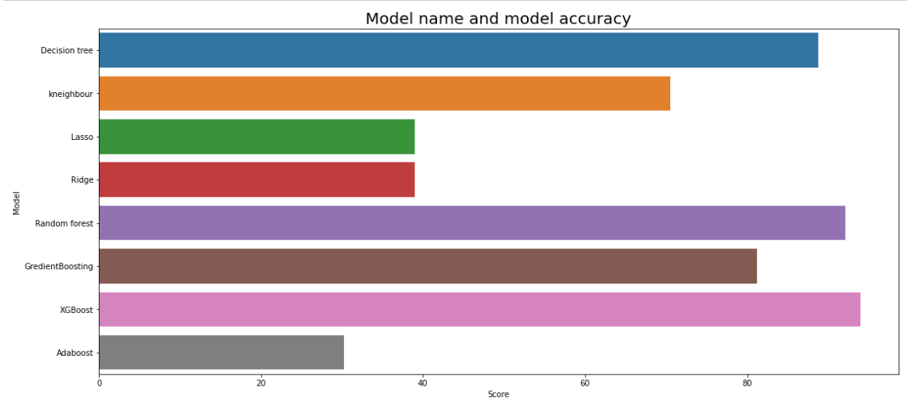

Slide 25
Best model–
Model name: XG Boost Regressor
r2 score: 95.60
Mean absolute error: 42211.92
Mean squared error: 5581440859.50
Root mean squared error: 74709.04
We got 95.60 % accuracy, which can be considers as a good accuracy for predicting the car price.
About XG boost regressor
XGBoost stands for Extreme Gradient Boosting, is a scalable, distributed gradient-boosted decision tree (GBDT) machine learning library. It provides parallel tree boosting and is the leading machine learning library for regression, classification, and ranking problems.
XGBoost is a powerful approach for building supervised regression models. The validity of this statement can be inferred by knowing about its (XGBoost) objective function and base learners. The objective function contains loss function and a regularization term.

Slide 26
In this paper, we built serveral regression models to predict the price of used car given some of the car features. We eveluated and compared each model to determine the one with highest performance. We also looked at how some models rank the features according to their importance. In this paper, we followed the data science process starting with getting the data, then cleaning and preprocessing the data, followed by exploring the data and building models, then evaluating the results and communicating them with visualizations.

